Slide 1
Welcome to East Preston Infants

Slide 2
Please return Baseline forms
We would normally have shared the following information with you at our first information meeting. We hope you find this information helpful.

Slide 3
Partnership between home and school
It is so important that we build a positive relationship with you and your child. We want your child to achieve to the very best of their ability at school. If we work together and have a shared vision it will help your child to reach their full potential.
We want to support you and your child in every way we can and creating a smooth transition into school really helps. This is a very different year for us and we would love to be meeting you face to face but that is not yet possible.

Slide 4

School Readiness
Notes:
We want you children to be happy, independent, curious, confident, sociable and ready to learn

Slide 5
Key Skills to have in place before starting school
Being able to get along with others and having strong social skills- taking turns, waiting for a turn, being kind
Coping emotionally with being separated from their parents/care givers
Being relatively independent in their own personal care- washing hands, wiping properly after going to the toilet, looking after belongings
Have a curiosity about the world and a desire to learn- asking questions, exploring the resources around them
Good communication and listening skills- being able to follow an instruction, recalling past experiences, talking about own interests
Notes:
This is about what we can do to get ready for supporting your child- what you can do and what your child will be able to do.

Slide 6
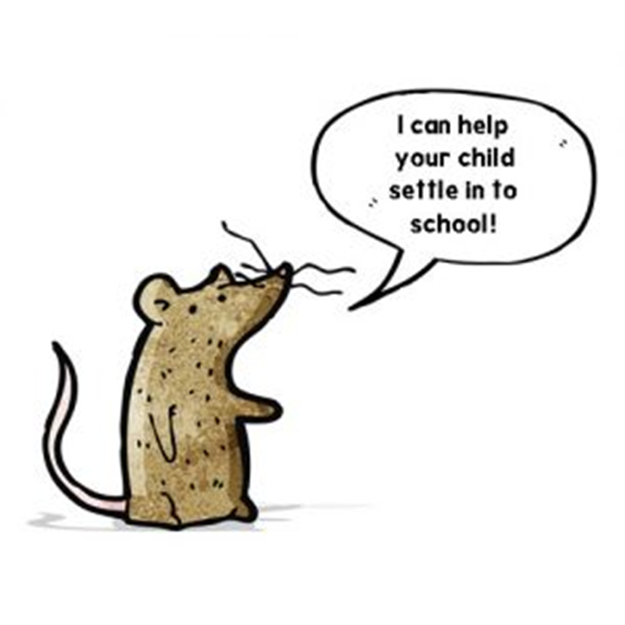
Mouse club- your child will have the toy to help, and activities to do at home. You can find handy hints and tips for getting your child ready for school.
Last year lots of parents commented on how great the ideas were and that they helped with a smooth transition and how to help their children be ready.
Quotes-
“Mouse Club really helped my child with their confidence”
“I thought my child was ready but still saw a massive improvement with listening skills and communication.”

Slide 7
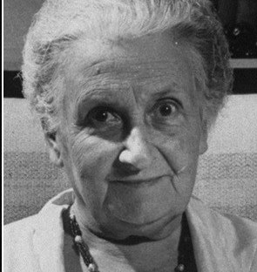
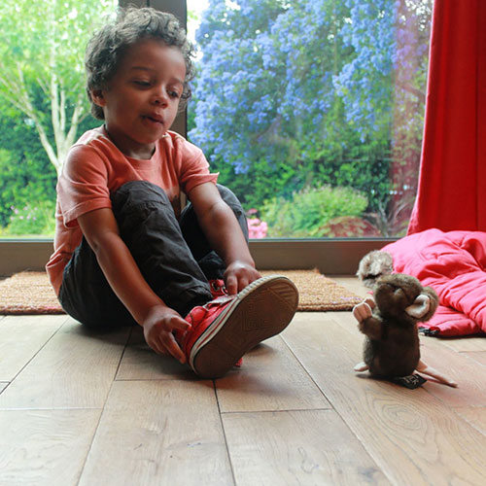
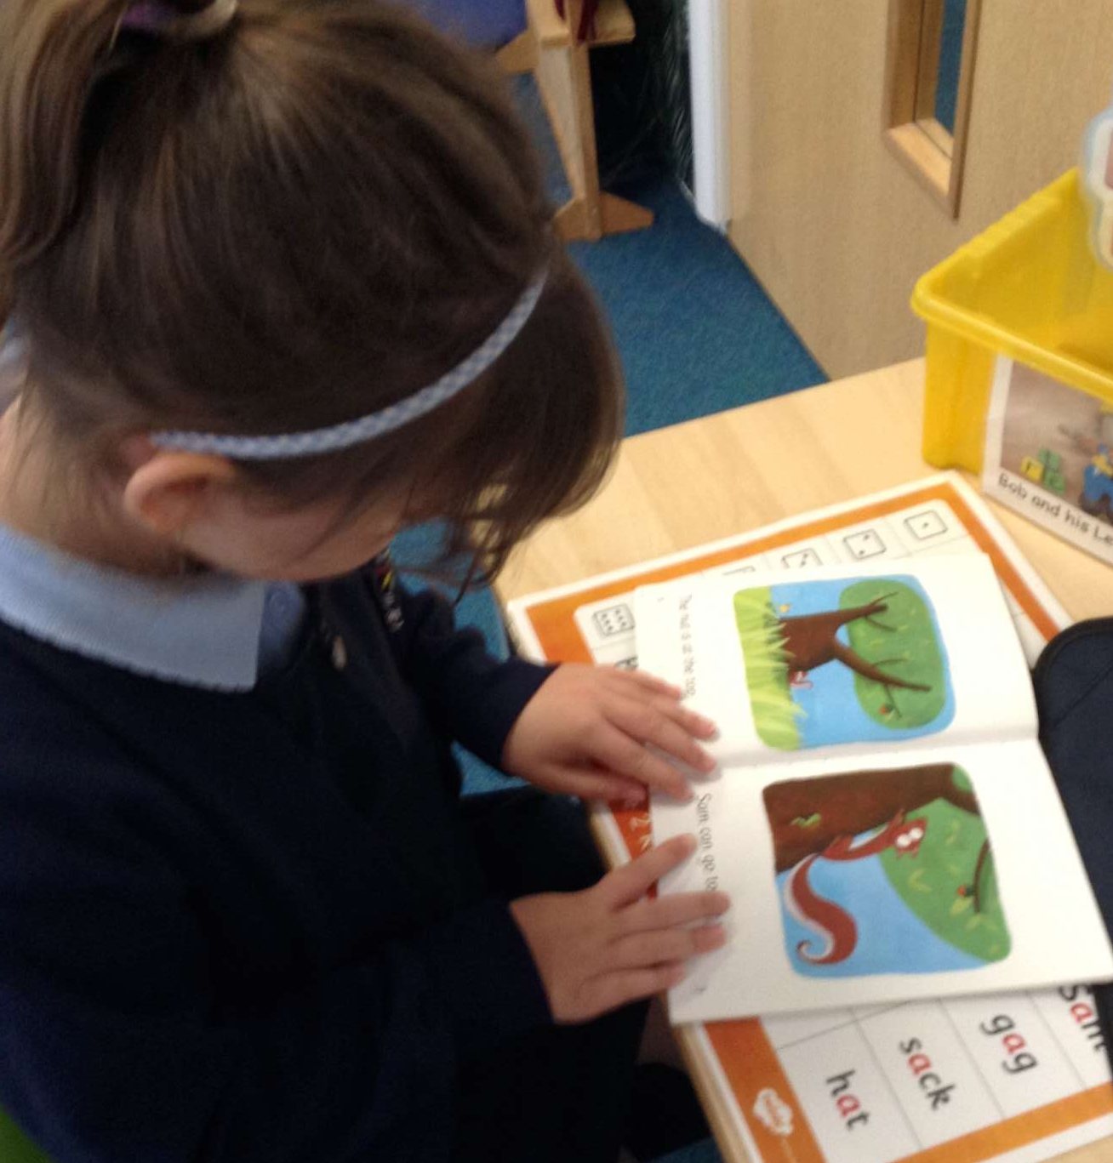
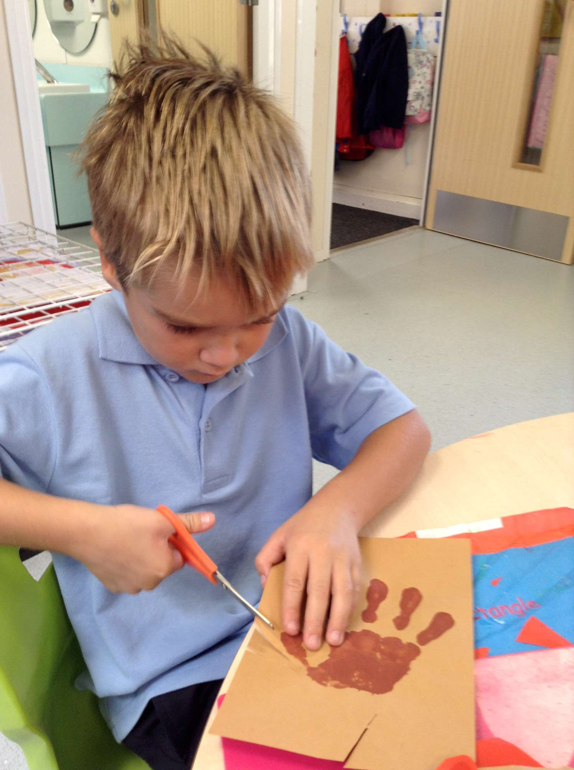
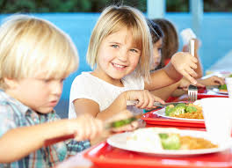
“Never help a child with a task at which they feel they can achieve.”
Maria Montessori

Slide 8
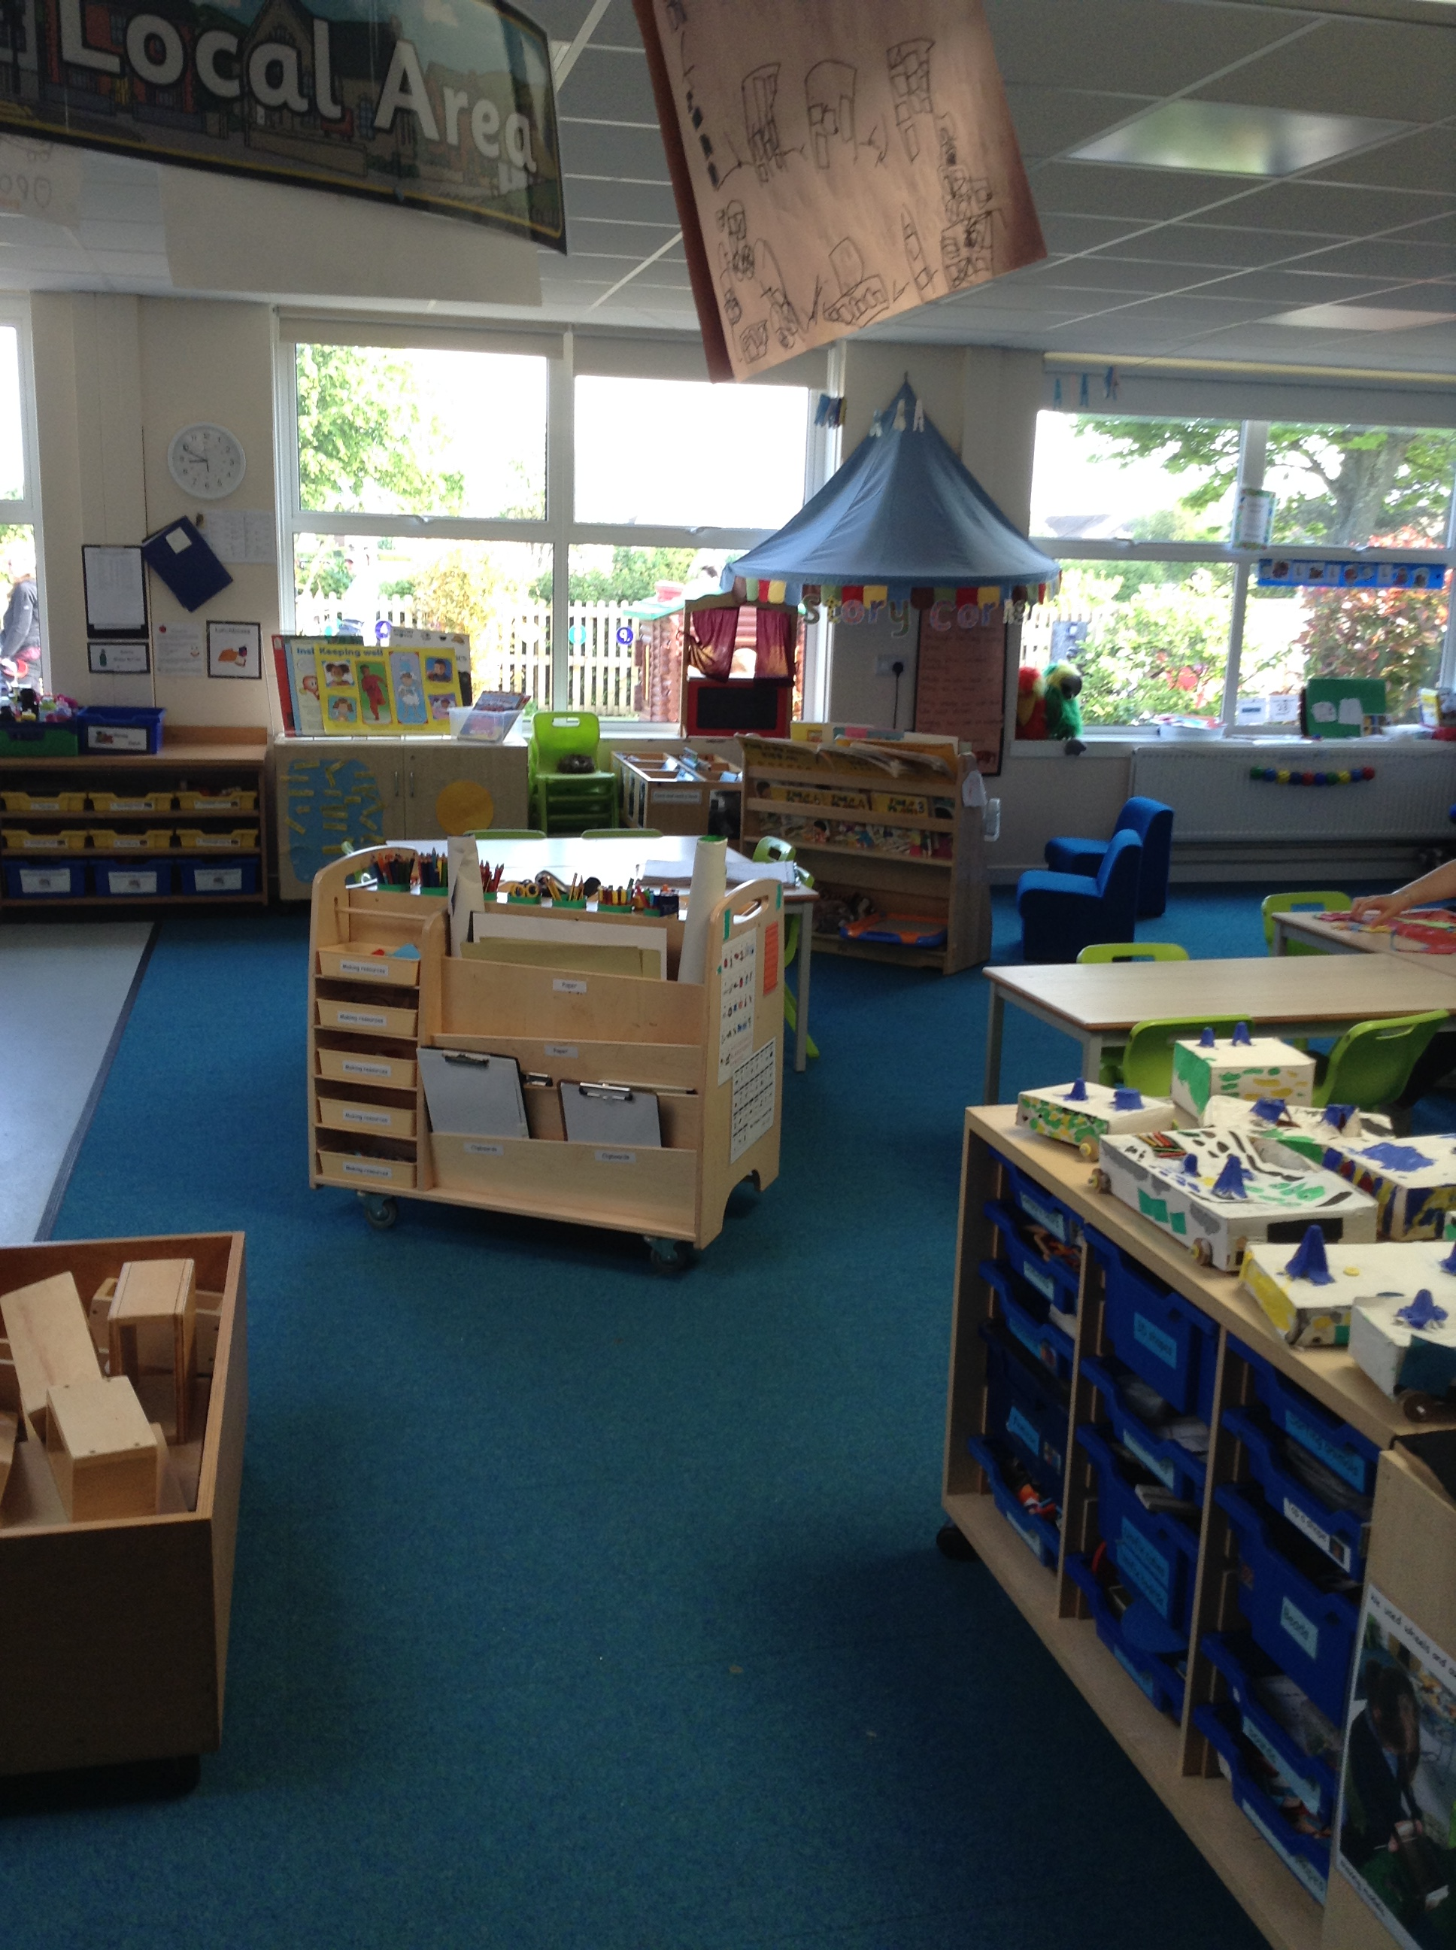
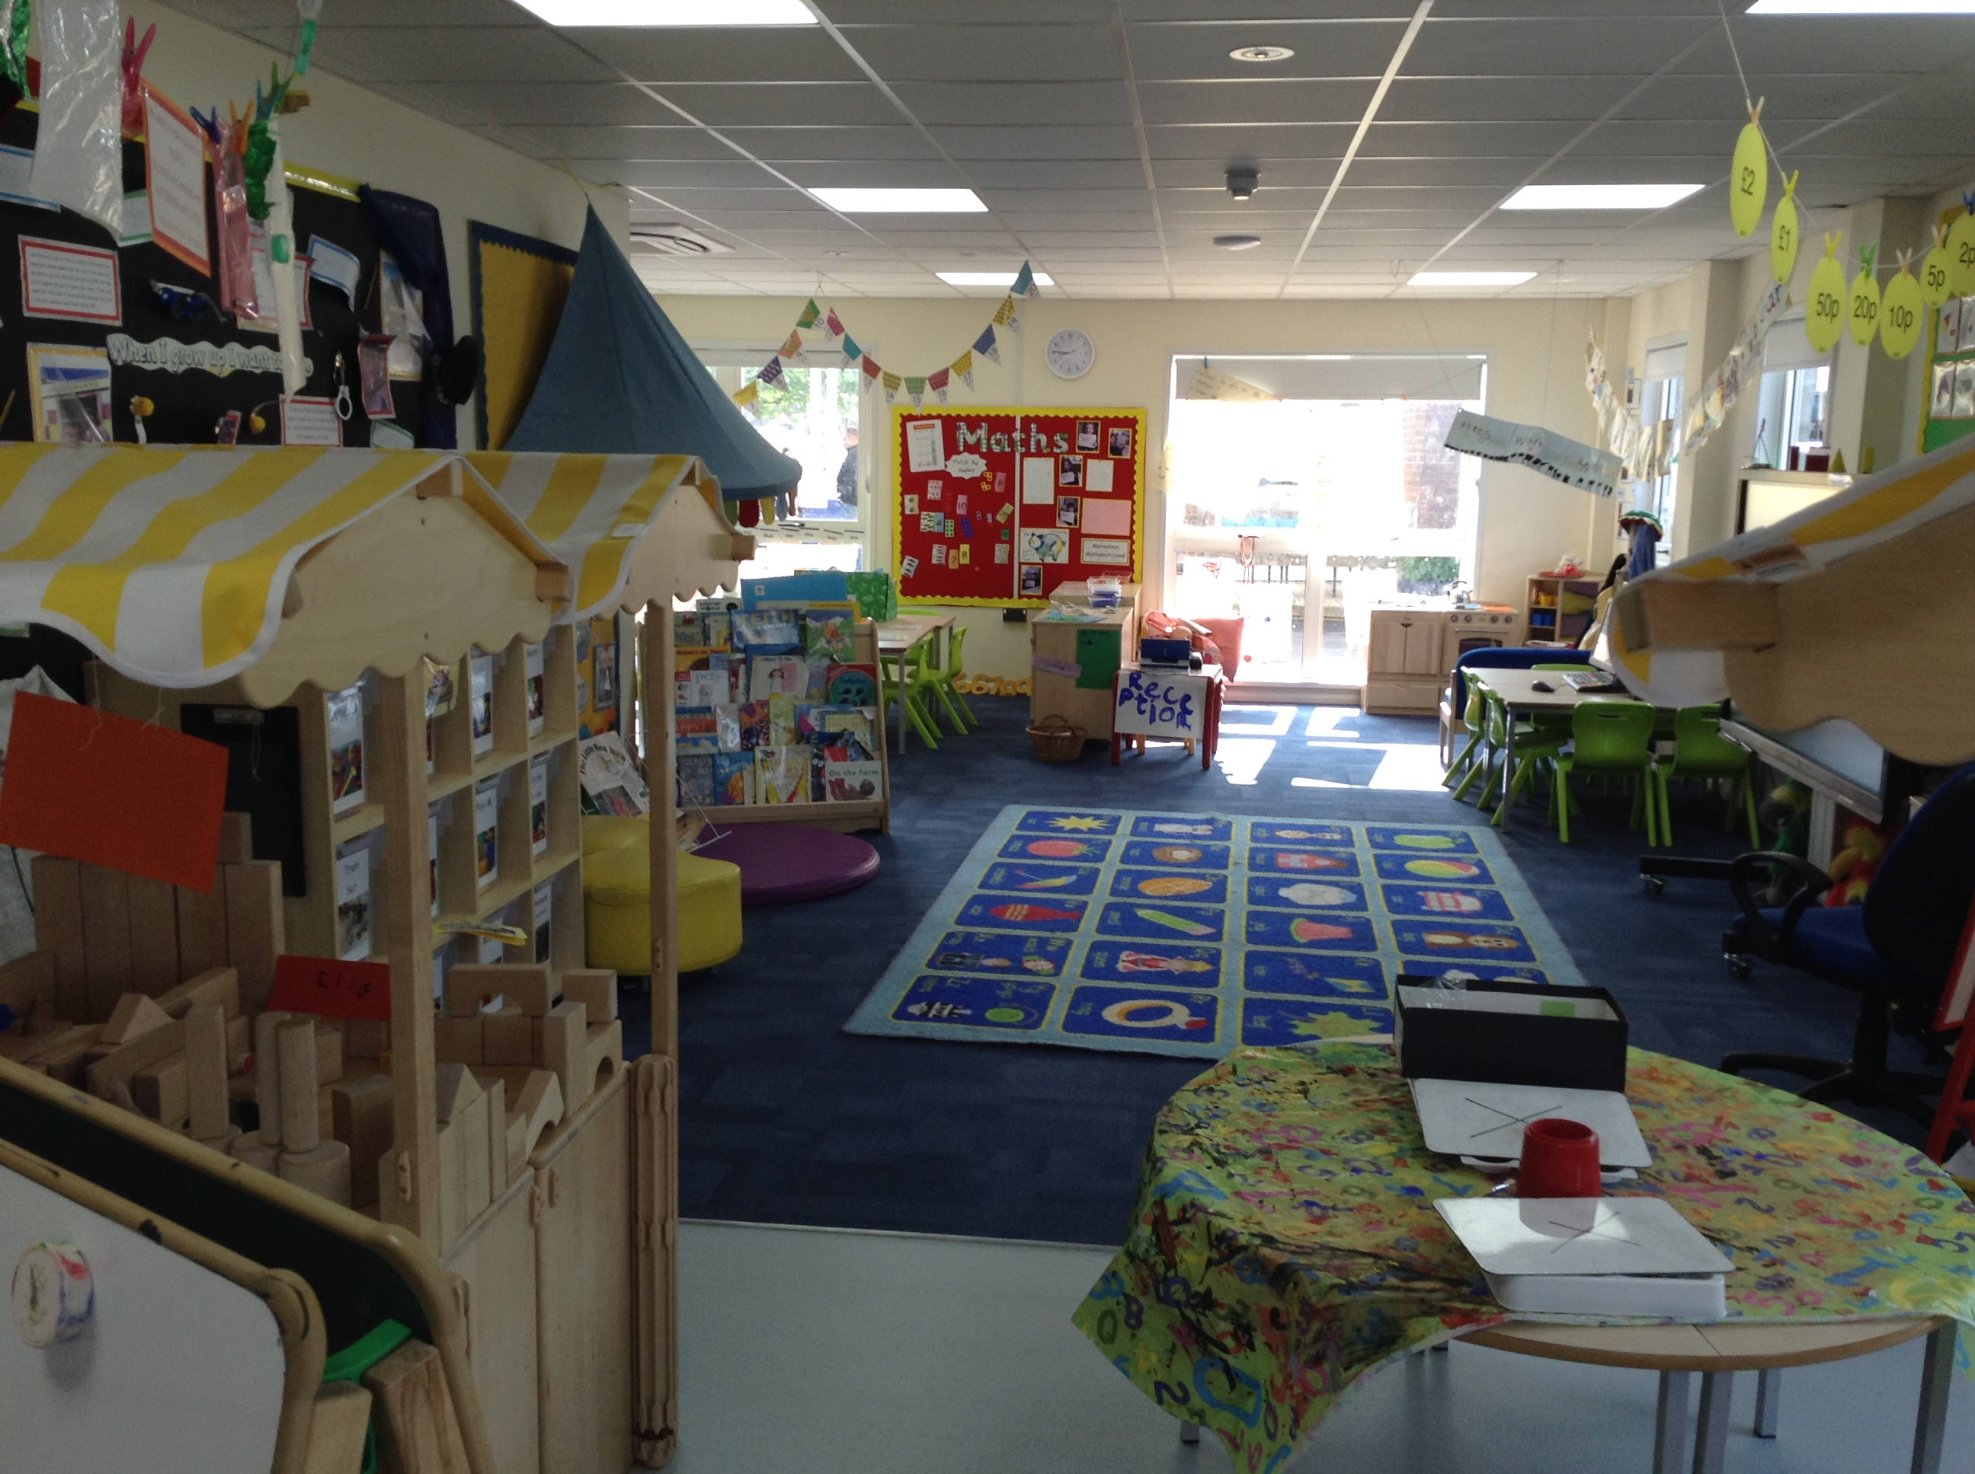
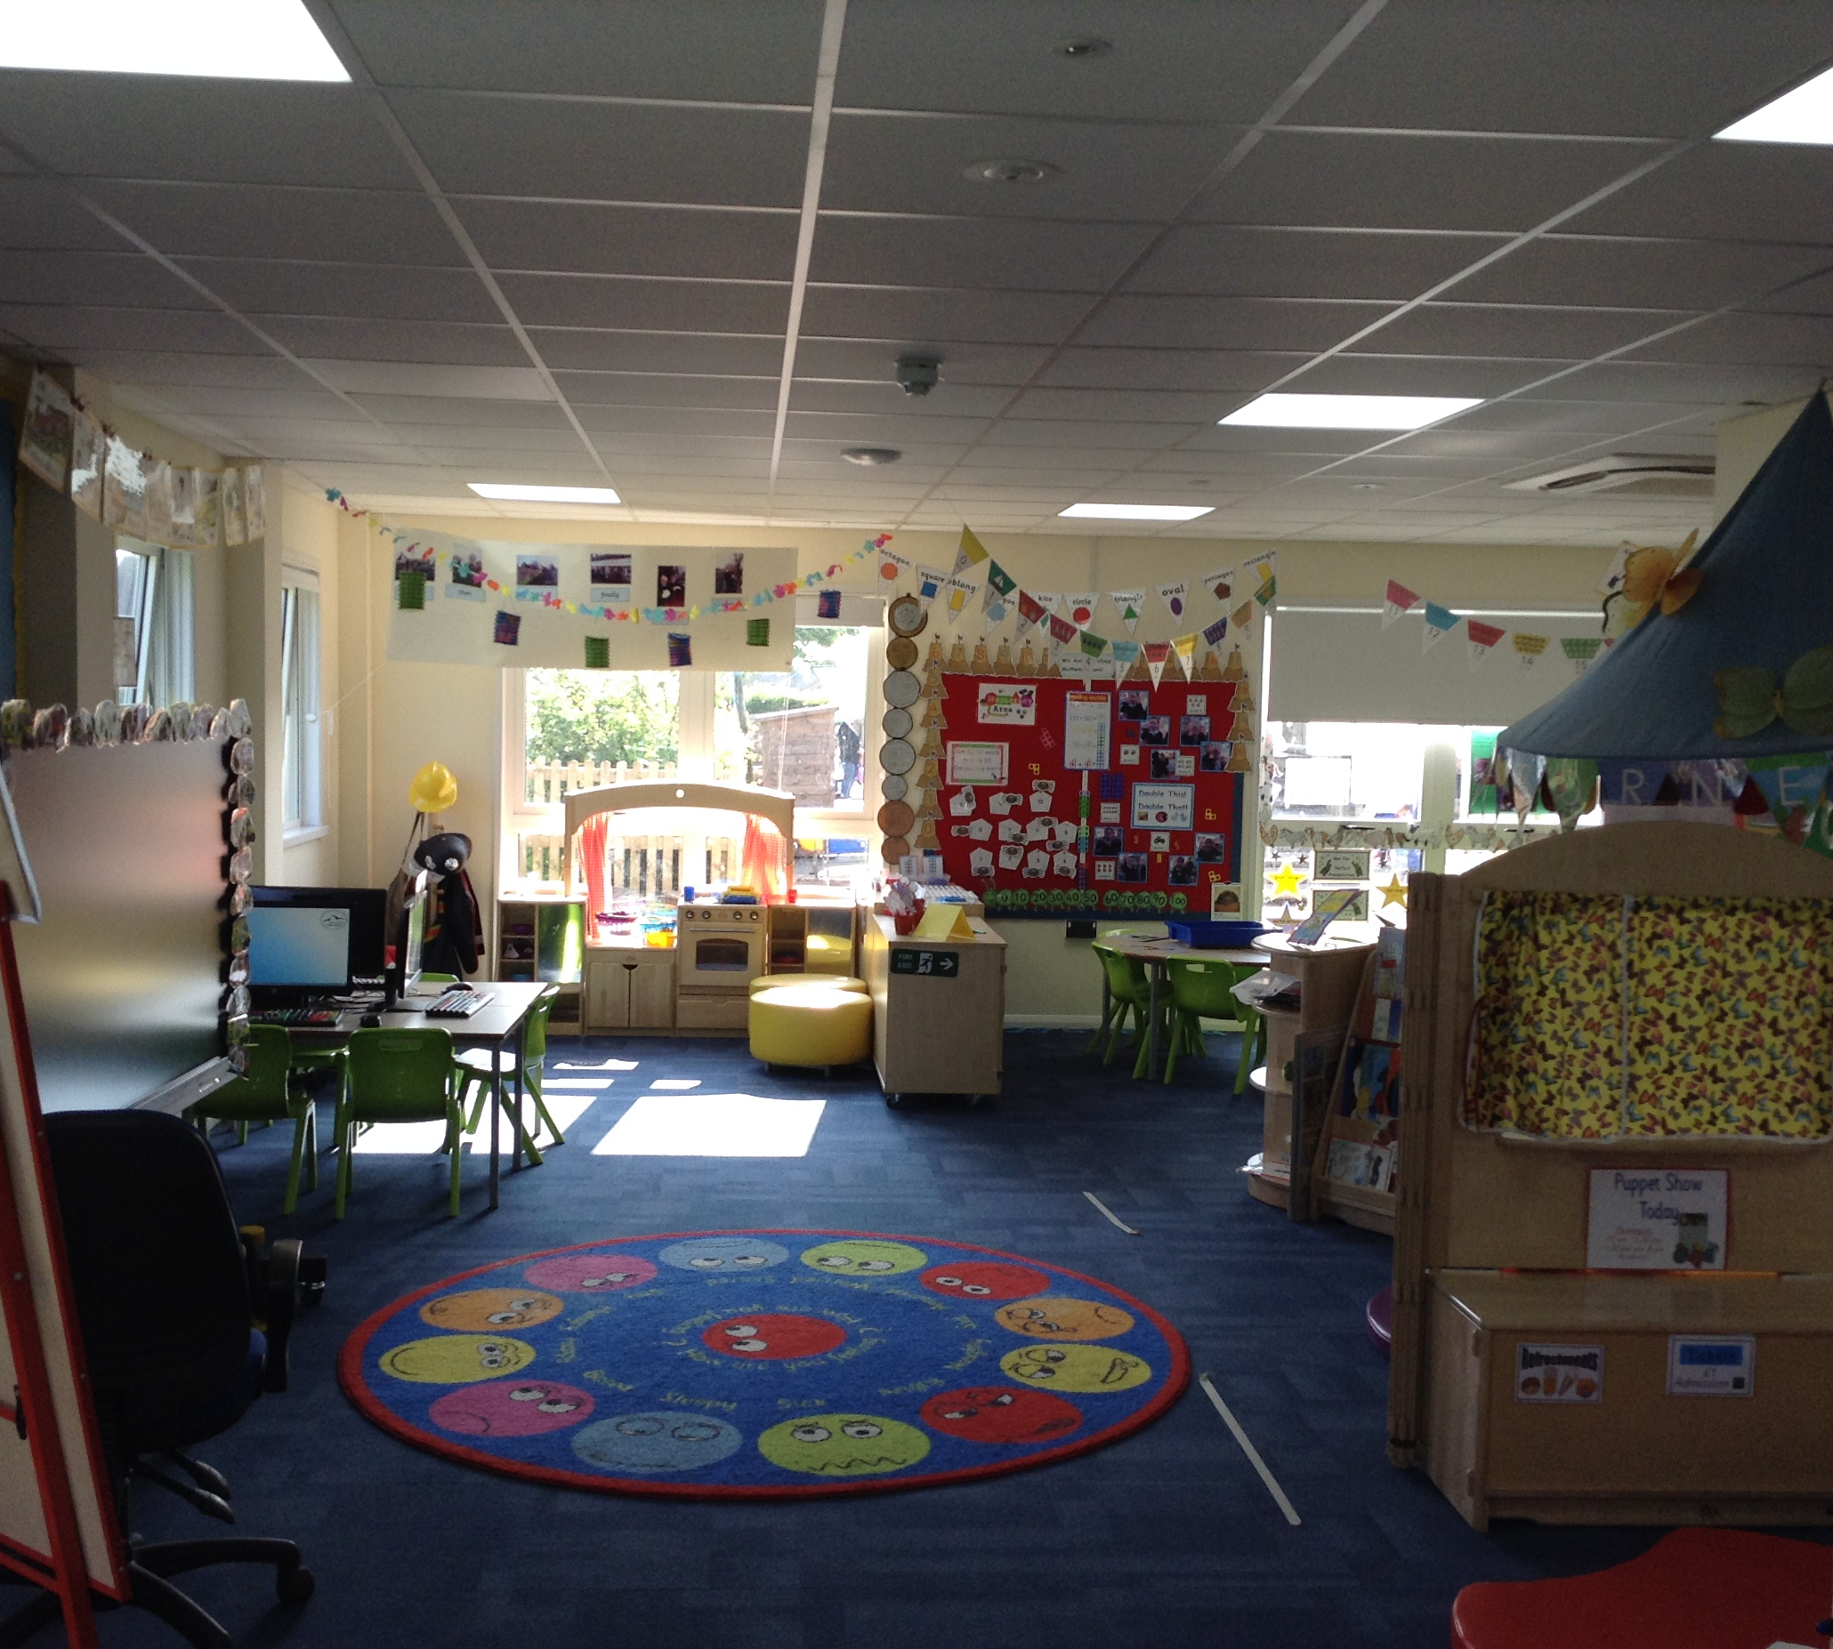
The Reception Classrooms
These are the Reception classrooms – Robins, Wagtails and Puffins
The children will be in one of these classes and also have access to the outside classroom. Every day the children need to be ready to learn and prepared so they have a successful day. Please ensure your child brings the things they need.
Monday
Water bottle with a sports lid ( this stays in school for the week and we wash and refill daily)
PE kit (this stays in school for the half-term)
Every day
Healthy snack if required ( please adhere to the school healthy snack policy)
Book bag and school reading diary
Notes:
On hand to answer questions.

